Slide 1
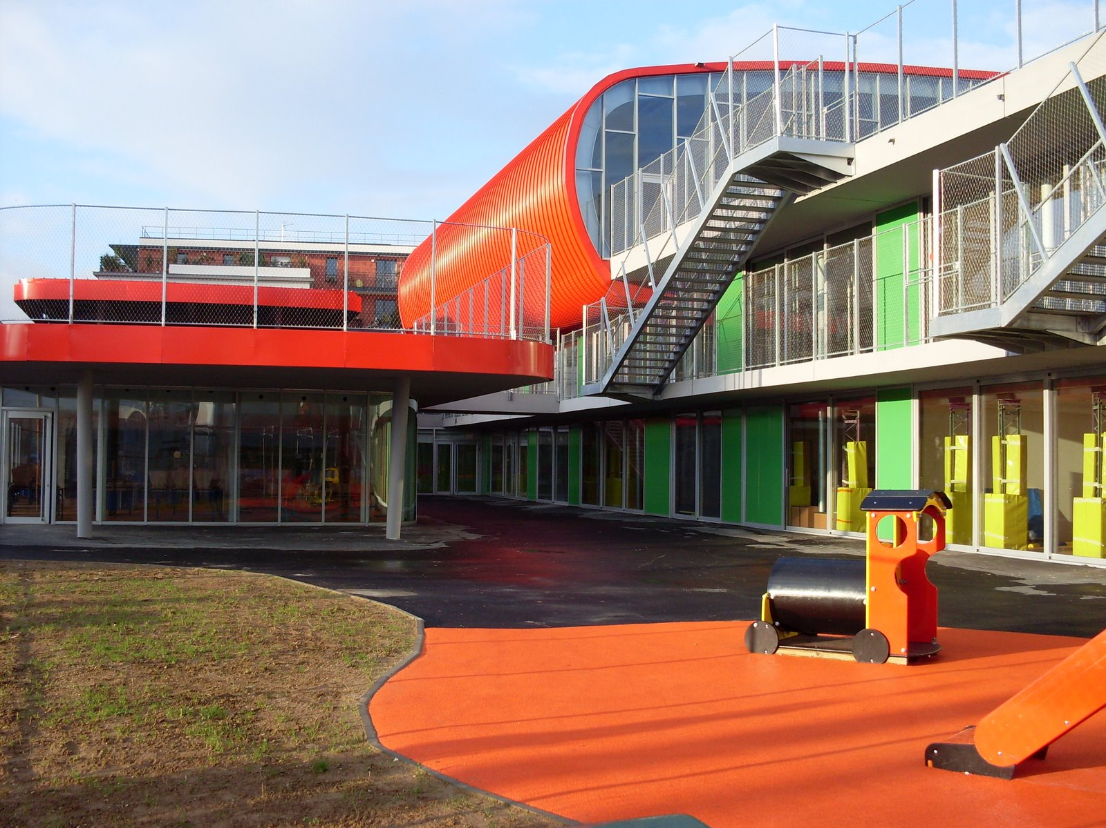
Ecole Primaire Les Chartreux
40 rue du Champ Chardon
92130 Issy les Moulineaux
France

Slide 2
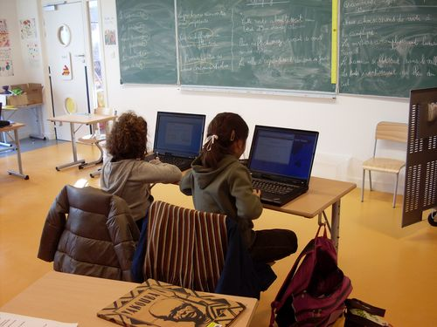
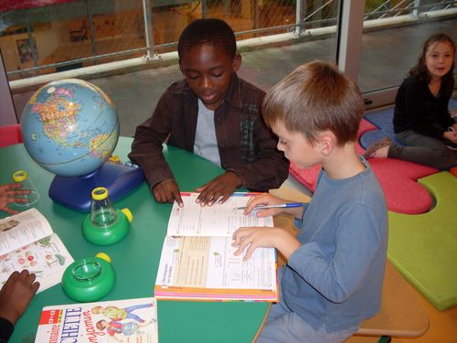
Vision of Innovation
The vision we share for our school, is a school where all the pupils, whatever their differences, can build the skills they need to become a responsible citizen in our world. We want collaborative pupils.
We think that autonomy will prepare pupils for the rest of their course.

Slide 3
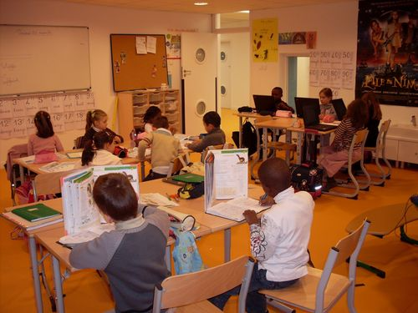
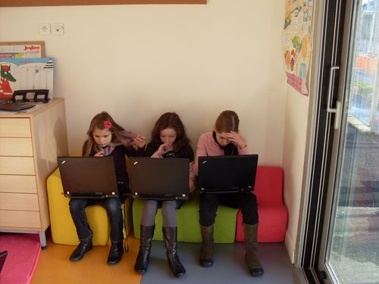
To reach that goal, the most important changes should be:
A new working environment (i.e : working in groups according to the needs)
A new organization of the working spaces in the school (using all the vacant spaces to permit to pupils to be responsible and actors of their learnings)
Increase the processes of self assessment (interactive document where the skills and capacities of the pupils are reported)
The Innovative School Program is an opportunity to define what we can build for our school, for the surrounding community and for other schools in the city. The challenge is to gather the educational community around this project and to have international contacts.

Slide 4
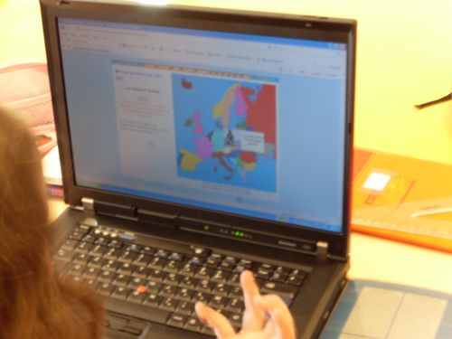
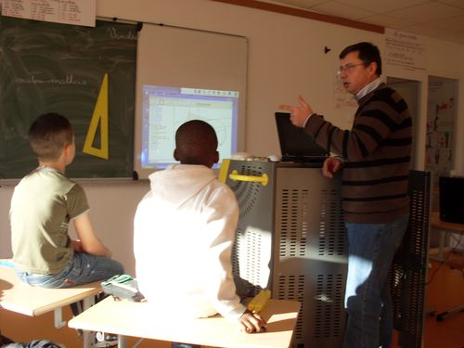
Current Status
Today, at school, we consider each pupil as being proactive in his learning, in acquiring knowledge and « how to do… » with his teacher.
We integrate ICT into every classroom in order to increase the learning potential and facilitate teaching.

Slide 5
After analysis of the results of our pupils evaluations, it appears that our efforts should be focused on 4 axes:
Access for all to citizenship
The culture as a base of their teachings
Differenciate the learnings and assistance to students experiencing difficulties.
Promote pupils autonomy and initiatives.
For that, it appears that it is important to develop skills in literacy. For us, the language is a very important tool and we have to increase the pupils skills in writing productions, oral presentations. It appears important to expand their vocabulary and their capacity of expression.
The control of the language is a mean to build an argumentation, to explain it and to validate it.

Slide 6
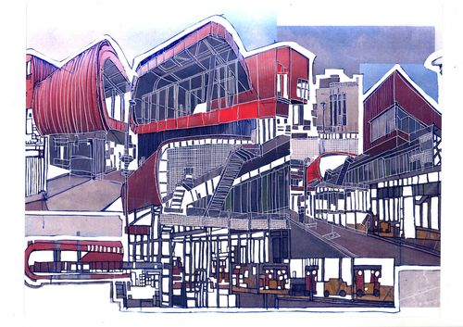
Since our school is a new school, that still is in the setting up phase, we need first to complete our equipment in the basic tools to be as efficient as possible in our work (i.e: educative games, equipment for motricity in pre-elementary…)
To complete this vision phase, we need
Numerical interactive whiteboards, more computers (to take into account the evolution of the school population)
Training on ICT and what they allow us to do with pupils
The top 3 things we most want to change in the next two years?
A common interactive numerical space of work for the whole educational community in order to share experiences, to allow a better self assessment process.
E-Twinning with other schools around the world.

Slide 7
Ideas for Attaining the Vision
To attain the vision for our school in those areas
Teaching, learning and assessment
Capacity building
Learning environment development
Student voice.
It is important to develop the collaboration with the surrounding partners. For instance, this kind of support is at the beginning and grows step by step with our evolution.
It would be an important thing to upgrade our initial training and to adapt our way of teaching.

Slide 8
Anticipated Challenges
The needs of our students is one of our main concerns, so to improve us in this area, we are looking for a better organization of the school.
Create an website of the school open to the surrounding community.
Create a common interactive numerical space of work for the whole educational community.
To discuss the best use of the available free spaces in the school with the building designer
Upgrade our initial training in order to have a better use of the ICT.
E-twinning with other school around the world.

Slide 9
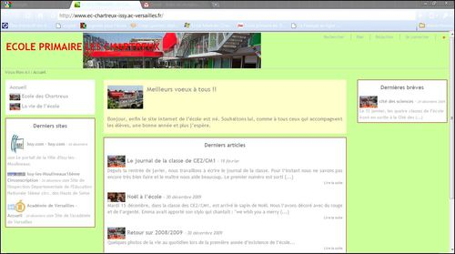
For the moment, we have created the website. It is filed by articles from the pupils, the teachers and in a near future, will be filed by the elected parents at the school council.
We are developing the organization of the school by fixing the Pedagogical Project of School
Contacts are taken with different partners to create the basis of our project.
We defined the planning roles and engagements and the stakeholder landscape

Slide 10
Stakeholder landscape Who needs to be engaged from the wider community of your school?

Slide 11
Planning roles and engagements

Slide 12
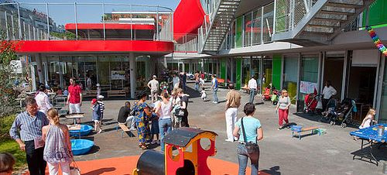
How can Innovative Schools community help?
We can find through the Innovative Schools community other ways to reach the goals we have. By sharing their experiences, we can develop new ideas and have a better vision of what can be innovation in our school.
The contact with other teachers is very rich and it allows us a best definition of what we can build for our school.

